Slide 1
GIT
Git is a distributed version control system that allows software developers to track changes in their codebase, collaborate with others, and manage their projects efficiently.it is one of the most widely used version control systems in the software development industry.

Slide 2
Key features of Git:
Version Control: Git tracks changes made to files in a repository over time. Each change is recorded as a commit, creating a complete history of the project.
Distributed: Unlike centralized version control systems, Git is distributed, meaning that every developer working on a project has a complete copy of the repository, including its history. This enables developers to work offline and independently until they choose to synchronize their changes with others.
Branching and Merging: Git allows developers to create branches to work on new features or bug fixes independently. Once a branch is complete, it can be merged back into the main codebase, facilitating parallel development without conflicts.

Slide 3
Collaboration: With Git, multiple developers can collaborate on the same project simultaneously. They can share their changes through a remote repository, review each other's code, and coordinate their work effectively.
Security and Integrity: Git uses cryptographic hashing to ensure the integrity of the repository. Each commit is identified by a unique hash, making it virtually impossible to tamper with the history of a project without detection.
Lightweight and Speed: Git is designed to be lightweight and fast. Operations such as committing, branching, and merging are performed locally, making them quick and efficient.
Open Source: Git is an open-source tool, allowing developers to contribute to its ongoing development and improvement.

Slide 4
Advantages of Git:
Complete History: Git keeps a detailed history of all changes made to a project, providing a clear record of who made what changes and when.
Parallel Development: With branching, developers can work on different features simultaneously without affecting each other's work, promoting efficient collaboration.
Offline Work: Since each developer has a complete copy of the repository, they can work offline and independently, making it easy to work from anywhere without constant internet connectivity.
Easy Rollback: Git's version control capabilities make it simple to revert to a previous state of the project if a bug or issue is introduced, improving code reliability.
Collaboration and Code Review: Git's distributed nature facilitates collaboration among developers, enabling effective code reviews and ensuring high-quality code.

Slide 5
Git Working Directory:
The working directory is the directory on your local machine where you store and modify your project files.
It contains the actual files that you are actively working on and editing.
When you make changes to files in the working directory, Git recognizes these changes as "unstaged" changes. In other words, they are modifications that are not yet scheduled to be included in the next commit.
The working directory is where you perform your day-to-day coding and development tasks.

Slide 6
Git Staging Area (Index):
The staging area is an intermediate step between the working directory and the Git repository.
It acts as a holding area where you can select and organize specific changes made to files in the working directory before committing them to the repository.
When you "stage" changes, you are preparing them to be included in the next commit. Staging allows you to be selective about which changes you want to include in a commit, making your commits more focused and organized.
The staging area is a crucial feature of Git's version control system, enabling developers to review and finalize changes before they become part of the permanent version history.

Slide 7
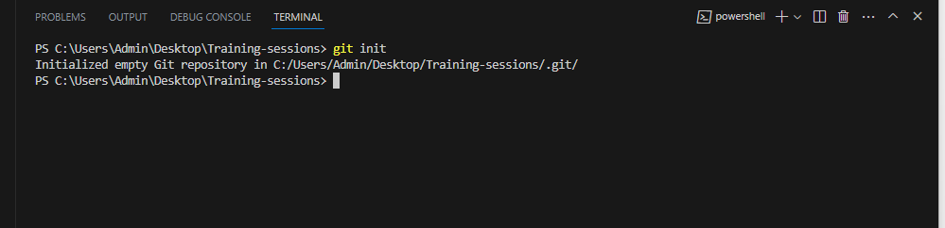
Basic commands of git
git init : Initializes a new Git repository in the current directory.

Slide 8
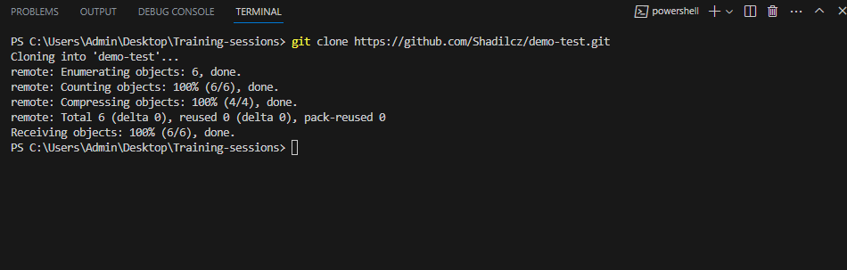
git clone <repository_url> : Copies an existing remote repository to your local machine.

Slide 9
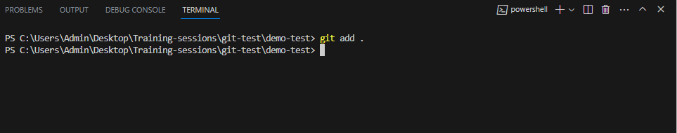
Now we cloned the file from our GitHub repo, now we can edit the files or add files to the repository by the following steps
After editing save the file to the same directory where we Initialized git.
here added a new file abc.txt and trying to commit it in to git
git add <file> : Adds changes made to a specific file to the staging area, preparing it for the next commit.
git add . or git add –all : Adds all changes made in the working directory to the staging area.

Slide 10
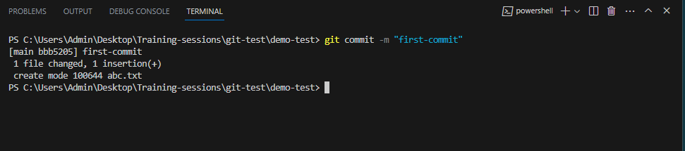
git commit -m "commit message“ : Creates a new commit with the changes in the
staging area along with a descriptive commit message.

Slide 11
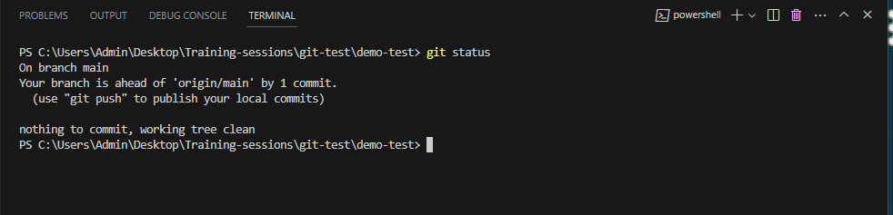
git status : Shows the status of the working directory, including modified, added, and untracked files.

Slide 12
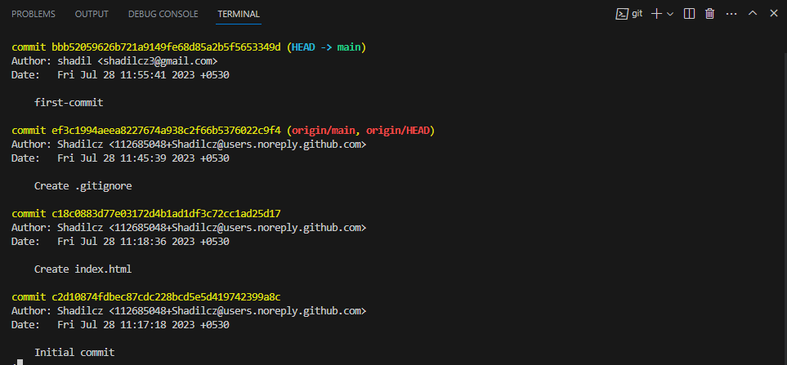
git log : Displays the commit history, showing author, date, and commit messages.

Slide 13
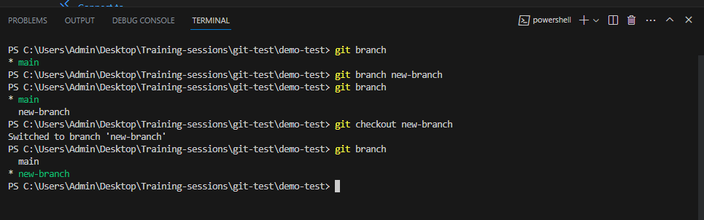
git branch : Lists all branches in the repository and highlights the current branch.
git branch <branch_name> : Creates a new branch with the specified name.
git checkout <branch_name> : Switches to the specified branch.

Slide 14
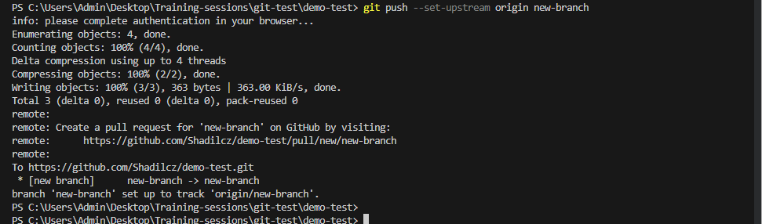
git pull : Fetches and merges changes from the remote repository to the current branch.
git push : Pushes committed changes from the local repository to the remote repository.
git push --set-upstream origin new-branch

Slide 15
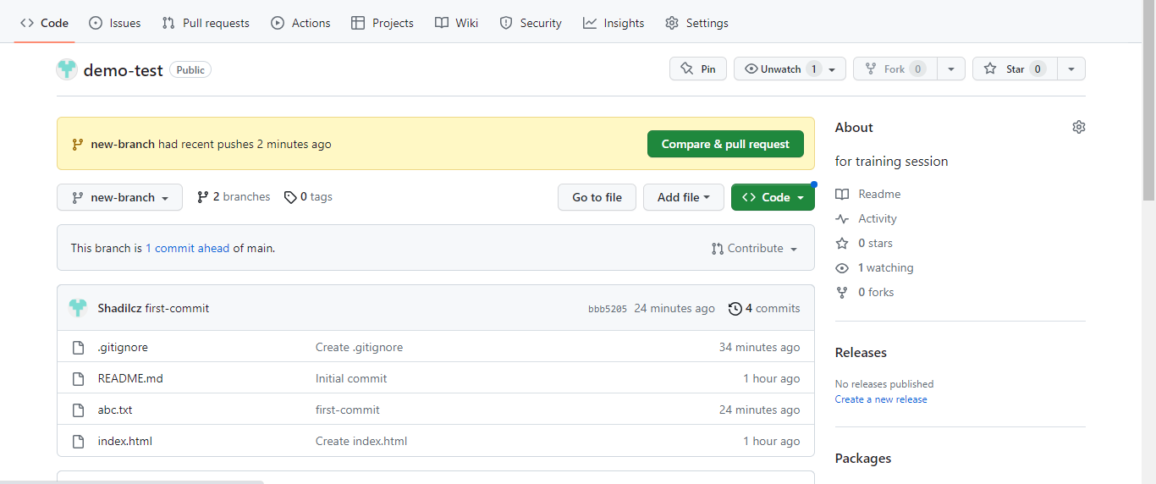
now we can see the new branch is created in GitHub and the file are pushed into it.

Slide 16
Reverting the Most Recent Commit:
If you want to undo the most recent commit, you can use the git revert command. This creates a new commit that undoes the changes introduced in the specified commit
git revert HEAD
The HEAD keyword refers to the most recent commit in the current branch.
Reverting a Specific Commit:
If you want to undo a commit other than the most recent one, you need to provide the commit's hash or a unique identifier. You can find the commit hash using git log.
git revert <commit_hash>
Replace <commit_hash> with the actual hash of the commit you want to revert.

Slide 17
CodeCommit
"CodeCommit" is a managed source code control service provided by Amazon Web Services (AWS). It offers a secure and scalable solution for hosting private Git repositories and managing version control for software development projects. CodeCommit is designed to seamlessly integrate with other AWS services and development tools, making it an attractive option for teams and organizations building applications in the AWS ecosystem.

Slide 18
Managed Git Repositories:
CodeCommit provides fully managed Git repositories, removing the need for maintaining version control infrastructure. It takes care of scaling, backups, and high availability.
Security and Access Control:
CodeCommit offers robust security features, including encryption at rest and in transit, to protect your code and data. Access control can be managed using AWS Identity and Access Management (IAM) policies, ensuring that only authorized users can access the repositories.
Integration with AWS Services:
CodeCommit seamlessly integrates with other AWS services, such as AWS CodePipeline, AWS CodeBuild, and AWS CodeDeploy, to automate the entire software development and deployment process.
Collaborative Development:
CodeCommit supports collaboration among team members, enabling developers to work together on the same repository simultaneously.

Slide 19
Branching and Code Merging:
Developers can create branches in CodeCommit to work on new features or bug fixes independently. Code merging tools help consolidate changes back into the main branch.
Code Review and Pull Requests:
CodeCommit supports code review workflows, allowing developers to request reviews and collaborate on improvements using pull requests.
Triggers and Notifications:
CodeCommit provides triggers to automate actions when specific events occur, such as commits or pull requests. This allows for custom workflows and integration with third-party services.
Backup and Disaster Recovery:
CodeCommit automatically backs up your repository data, ensuring data durability and offering disaster recovery options.

Slide 20
Working steps to set up and use AWS CodeCommit:
Step 1: Install and Configure Git
If you haven't already, install Git on your local machine.
Configure Git with your name and email address:
git config --global user.name "Your Name"
git config --global user.email "your.email@example.com"
Step 2: Create an IAM User
Create an IAM user with programmatic access and the necessary permissions to access CodeCommit. Attach the AWSCodeCommitPowerUser policy to this user.
Note down the Access Key ID and Secret Access Key provided during user creation.

Slide 21
Step 3: Configure AWS CLI
Install the AWS Command Line Interface (CLI) on your local machine.
Configure the AWS CLI with the Access Key ID and Secret Access Key from the IAM user you created
aws configure
Step 4: Create a CodeCommit Repository
From the AWS Management Console navigate to the CodeCommit service.
Click on "Create repository."
Enter a name for your repository and configure any additional settings as needed.
Click on "Create repository" to create your CodeCommit repository.

Slide 22
Step 5: Clone the Repository
Back on your local machine, navigate to the directory where you want to clone the repository.
Clone the repository using the HTTPS URL provided in the CodeCommit console:
git clone https://git-codecommit.{region}.amazonaws.com/v1/repos/{repository-name}
Step 6: Start Coding and Making Changes
Navigate into the cloned repository directory
cd {repository-name}
Start coding and making changes to your project files.
Step 7: Add and Commit Changes
Stage the changes you want to include in the commit:

Slide 23
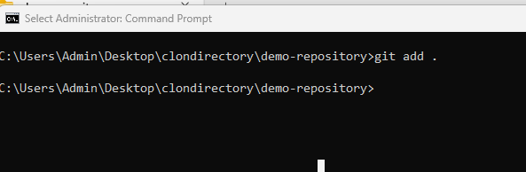
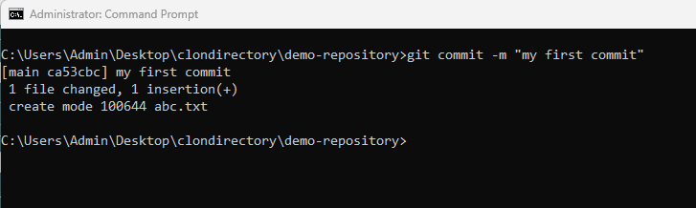
git add . # Add all changes
git add <file> # Add specific file
Create a commit with a commit message:
git commit -m "Your commit message here"

Slide 24
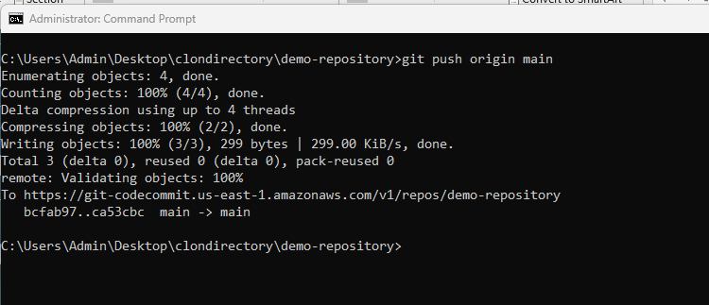
Step 8: Push Changes to CodeCommit
Push your committed changes to the CodeCommit repository:
git push origin main # Push to the 'master' branch (or your main branch)

Slide 25
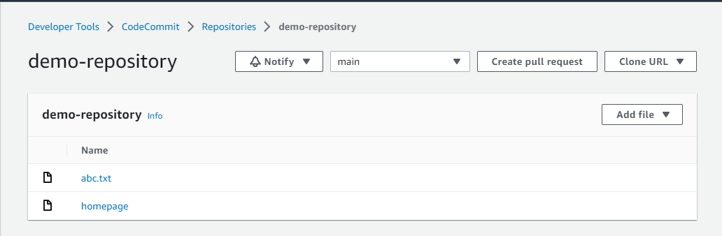
Step 10: Review in CodeCommit Console
Go back to the CodeCommit console, navigate to your repository, and you'll see your pushed changes in the commit history.

Slide 26
Amazon Simple Storage Service
Amazon Simple Storage Service (S3) is a fully managed object storage service offered by Amazon Web Services (AWS). It provides developers with a scalable and durable solution for storing and retrieving any amount of data in the AWS cloud. In S3, data is organized into "buckets," and each bucket can hold an unlimited number of "objects." Each object is identified by a unique "key" within the bucket.

Slide 27
Key Features and Benefits:
High durability
Scalability,Allowing users to seamlessly store and retrieve any amount of data.
The service provides high availability, ensuring that data is readily accessible from anywhere in the world.
The pricing model for Amazon S3 follows a pay-as-you-go approach.
The ability to store and retrieve data at any time make it a cost-effective storage solution.
S3 provides a versioning feature that allows users to preserve, retrieve, and restore every version of an object stored in the bucket.
Use Cases:
Amazon S3 finds application in various use cases across industries,
S3 provides a reliable and secure repository.
Content creators and distributors use S3 for storing and delivering multimedia content, ensuring low-latency access to users worldwide.
In big data analytics, S3 serves as a cost-efficient data lake for storing and processing vast amounts of data.
Hosting static websites on S3 allows for scalable and highly available web hosting.

Slide 28
Event Notifications and Triggers:
S3 event notifications allow users to respond to changes in the bucket, such as object creation, deletion, or restoration, by invoking AWS Lambda functions or sending notifications via Amazon Simple Notification Service (SNS). This enables users to trigger automated workflows and notifications based on S3 events.

